Slide 1


A Modular Multi-Agent AI System for Anomaly Detection in Fitbit Data
Welcome to our presentation on AI-driven fitness analytics. We'll explore how artificial intelligence transforms exercise data into actionable insights.
This system detects anomalies in fitness patterns and monitors performance using sophisticated AI techniques.
by Noora Alboinin
Notes:
Hello, and welcome to my presentation on an AI-Based Performance Monitoring and Fitness Data Analysis System.
In this session, I’ll walk you through how artificial intelligence, combined with multi-agent architecture, can transform wearable fitness data into actionable insights for health and performance monitoring.
We’ll explore a real-world case study using Fitbit data, focusing on detecting anomalies in daily activity, sleep patterns, and cardiovascular indicators.
This project brings together key concepts from data science, unsupervised learning, and agent-based computing, with the ultimate aim of creating a smarter, modular, and more proactive fitness tracking system.
My name is Noora Alboinin, and I’m excited to take you through the design, implementation, and future potential of this AI-driven solution.

Slide 2





Project Objective & Dataset
Objective
Detect anomalies and monitor fitness using Fitbit data
Dataset
Fitbit daily activity, sleep, heart rate, and exercise
Sample Size
date | total_steps | distance_in_kms | total_calories | floors | elevation | distance_in_miles | total_sleep_minutes | demographicVO2Max | sleep_score | deep_sleep_in_minutes | resting_heart_rate | activityName | total_exercise_minutes | MONTH | DAYOFWEEK
2020-12-13 | 3694.0 | 2.68407 | 2091.0 | 1.0 | 3.0 | 1.667800576 | 452.0 | 50.32151 | 79.0 | 41.0 | 59.0 | Walk | 42.65 | Dec | Mon
2020-12-14 | 9460.0 | 6.85782 | 2639.0 | 1.0 | 3.0 | 4.261243613 | 414.0 | 50.20421 | 70.0 | 42.0 | 57.0 | Walk | 32.43333333 | Dec | Tue
2020-12-15 | 9239.0 | 6.71307 | 2841.0 | 4.0 | 12.0 | 4.171300306 | 417.0 | 50.62927 | 73.0 | 22.0 | 57.0 | Walk | 74.23333333 | Dec | Thu
2020-12-16 | 6384.0 | 4.63862 | 2471.0 | 1.0 | 3.0 | 2.882299309 | 481.0 | 50.94084 | 82.0 | 31.0 | 56.0 | Walk | 20.46666667 | Dec | Fri
2020-12-17 | 11806.0 | 8.55429 | 2904.0 | 3.0 | 9.0 | 5.315379177 | 445.0 | 50.9435 | 73.0 | 20.0 | 55.0 | Walk | 69.98333333 | Dec | Fri
1661 records with comprehensive metrics
Key Features
Total steps, sleep score, VO2Max, heart rate
Notes:
The main objective of this project is to detect anomalies in personal fitness data and monitor performance using artificial intelligence.
To achieve this, I adopted a modular multi-agent system (MAS) architecture. This approach offers both scalability and separation of concerns, which aligns with best practices in agent-based computing (Wooldridge, 2009). Each agent is designed to handle a specific function — from data retrieval to validation, analysis, and reporting — enabling a maintainable and extensible system.
The dataset used in this project was sourced from Kaggle, originally published by LinkNet Analytics in 2023. It contains over 1,600 records of daily Fitbit data, capturing key health-related metrics such as total steps, heart rate, calories burned, VO2Max, and various sleep quality indicators.
These features offer a multidimensional view of physical performance, making them ideal for detecting behavioral deviations. For example, fluctuations in VO2Max or sleep scores can signal reduced cardiovascular health or disruptions in routine, which are both important from a wellness monitoring perspective.
This dataset not only provides a rich empirical foundation for AI-driven analysis but also supports the practical goal of delivering interpretable, real-time health insights using intelligent systems.

Slide 3





System Architecture
2. Data Validation Agent
Ensures data quality and integrity
1. Data Retrieval Agent
Fetches raw fitness data from devices
3. AI Analysis Agent
Processes data and detects anomalies
5. Security Agent
Protects user data privacy
By modularising the system with agents, we mimic real-world distributed systems, allowing future integration with IoT or streaming environments.
4. Reporting Agent
Generates insights and visualizations
Notes:
To structure the system effectively, I adopted a Multi-Agent System (MAS) architecture, inspired by the principles outlined by Wooldridge (2009), who highlights the value of modular, intelligent agents in distributed systems.
In this architecture, each agent has a dedicated role, promoting separation of concerns and ensuring the system is both scalable and maintainable.
The Data Retrieval Agent is responsible for accessing and loading the Fitbit dataset.
The Data Validation Agent ensures data quality by handling missing values, applying standardisation, and formatting the data.
The AI Analysis Agent applies machine learning techniques — primarily the Isolation Forest algorithm — to detect anomalies in user behavior.
The Reporting Agent generates visualisations and summaries to support interpretation and communication of the findings.
Finally, the Security Agent is currently simulated, but serves as a placeholder for future integration of secure data handling mechanisms, such as OAuth protocols or encrypted APIs.
This modular agent-based pipeline not only mirrors how intelligent systems operate in real-world contexts, such as health monitoring platforms or Industry 4.0 ecosystems, but also prepares the system for future extension into IoT or streaming environments.

Slide 4



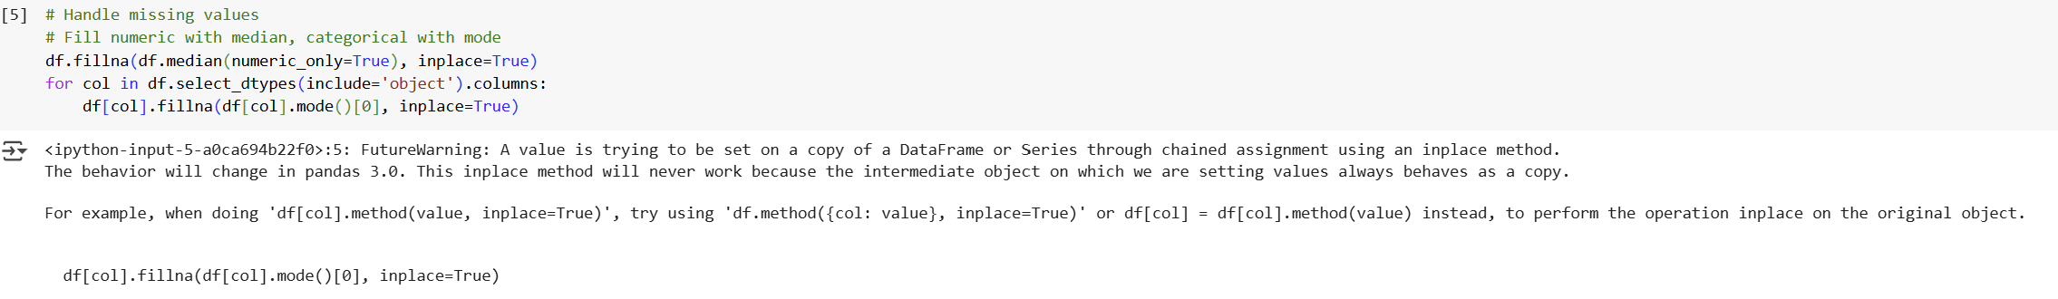
Data Cleaning & Preprocessing
Missing Values
Numeric: median, categorical: mode
Date Conversion
Converted to datetime format
Standardization
Z-score normalization of numerical features
Notes:
Before applying any machine learning techniques, it was crucial to ensure the dataset was clean, consistent, and analytically reliable. This stage directly impacts model performance, especially when working with unsupervised algorithms like Isolation Forest.
First, I addressed missing values. For numerical features—such as total steps, distance, and calories—I applied the median rather than the mean, due to its robustness against outliers. For categorical features like activity names, I used the mode, which reflects the most frequent category. This approach balances statistical accuracy and practical simplicity.
Second, I converted the date column to a datetime format, enabling accurate time-series operations and chronological ordering, which are foundational for detecting behavioural trends over time.
Third, I applied z-score standardization to all numerical inputs. This transformation ensures a consistent scale across variables, which is particularly important for distance-based models like Isolation Forest that are sensitive to variance in feature magnitudes.
As highlighted by Russell and Norvig (2021), the success of any AI system is rooted in the quality of its data. Without effective preprocessing, models can produce biased or misleading results, no matter how advanced the algorithm.
Finally, a before-and-after comparison of missing values confirmed that the cleaning process was successful. This increased the statistical integrity of the dataset and prepared it for robust anomaly detection.

Slide 5
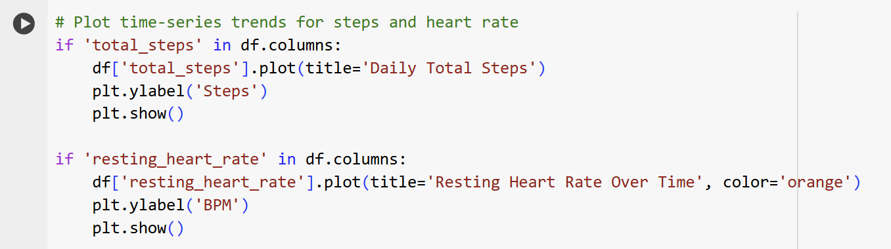
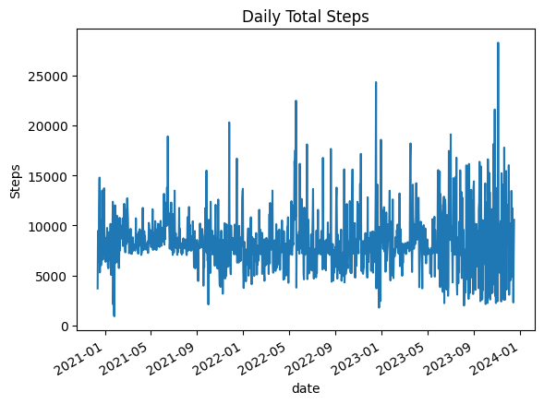
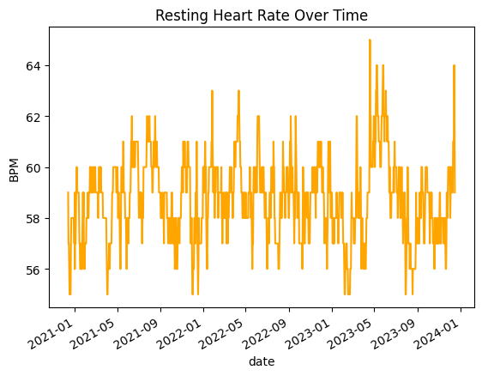
Exploratory Data Analysis
Daily steps showed cyclical patterns, indicating consistent weekly exercise habits.
Resting heart rate trends reflected cardiovascular fluctuations across time.
A moderate correlation (r = 0.47) between VO2Max and sleep score suggests a link between fitness and sleep quality.
Notes:
To start the analysis, I conducted an exploratory data review to identify patterns that could inform the anomaly detection model.
The first plot, showing daily total steps, revealed cyclical variability over time. This suggests consistent weekly exercise habits, which serve as a baseline for identifying deviations in physical activity.
The second plot tracks resting heart rate, providing insight into cardiovascular trends. Periods of elevated or irregular heart rate may indicate changes in health status or recovery patterns.
To explore relationships across features, I used a correlation heatmap. One notable finding was a moderate positive correlation—r = 0.47—between VO2Max and sleep score, suggesting that individuals with better cardiovascular fitness tend to experience higher sleep quality.
These findings established behavioural baselines and supported the selection of features used in anomaly detection, ensuring the AI model was grounded in meaningful, data-driven insights.

Slide 6
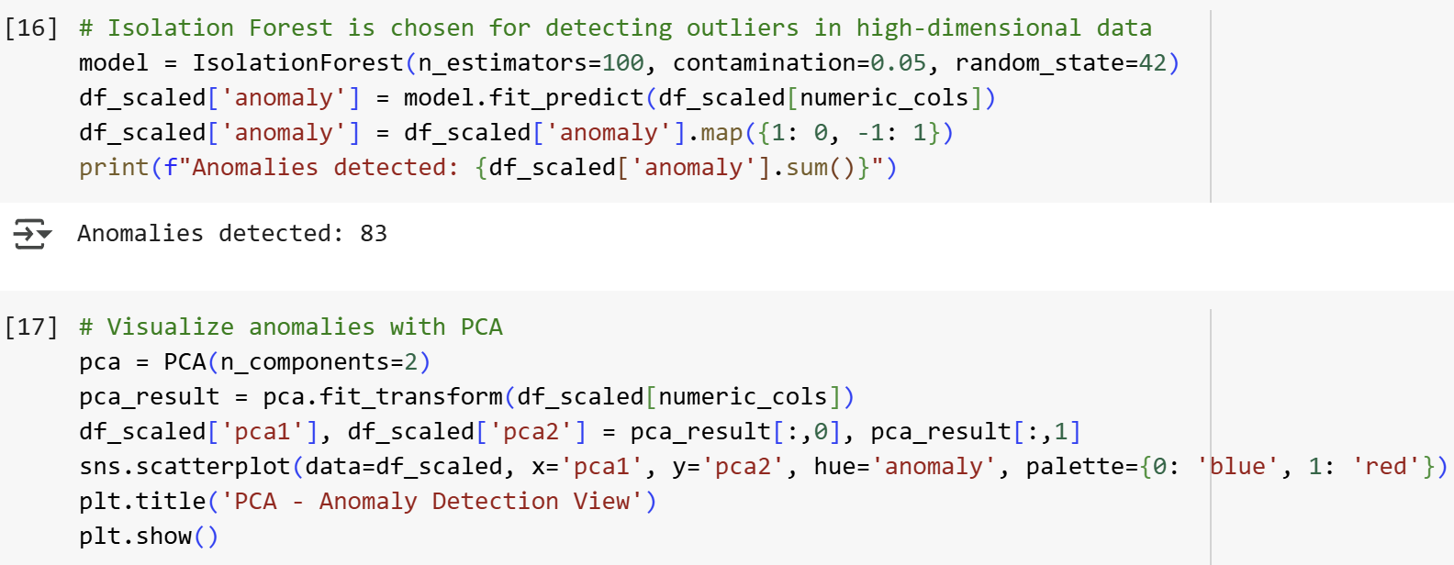
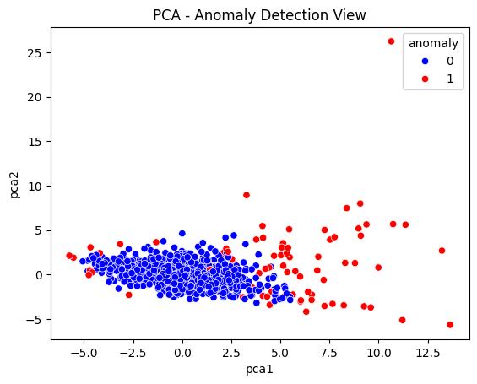
Anomaly Detection
(Isolation Forest)
Isolation Forest
effective for high-dimensional, unlabeled data.
Isolates outliers via random splits.
5% Contamination
Set threshold flags unusual patterns in fitness data
PCA Visualization
Dimensionality reduction enables clear 2D visualization of anomalies
Notes:
The core AI component in this system is anomaly detection, designed to identify patterns in fitness data that deviate significantly from typical behavior.
For this purpose, I selected the Isolation Forest algorithm—an unsupervised learning method known for its efficiency in handling high-dimensional, unlabeled data. It operates by constructing isolation trees through random feature and value splits, enabling it to isolate anomalies faster than traditional clustering techniques. This made it particularly effective for detecting unusual spikes in daily steps or irregular sleep and heart rate patterns.
To enhance interpretability, I applied Principal Component Analysis (PCA) after the model generated predictions. PCA reduced the data to two dimensions, allowing for a clear 2D visualisation of how anomalies (red points) deviate from normal observations (blue points). It’s important to note that PCA was used only for visualisation, not during model training. This approach aligns with best practices discussed by Russell and Norvig (2021), who highlight the importance of interpretable AI systems in real-world applications.
The PCA scatterplot validated the model’s effectiveness—clear separation between normal and anomalous data indicated reliable anomaly detection.
I configured a 5% contamination rate, meaning the model expected around 5% of the dataset to be anomalous. This value was chosen to balance sensitivity (detecting true anomalies) and precision (avoiding false positives).
Other anomaly detection methods like One-Class SVM and DBSCAN were also evaluated. However, these proved less suitable for this project due to their sensitivity to parameter tuning and poor performance on datasets with mixed numeric and categorical variables.

Slide 7
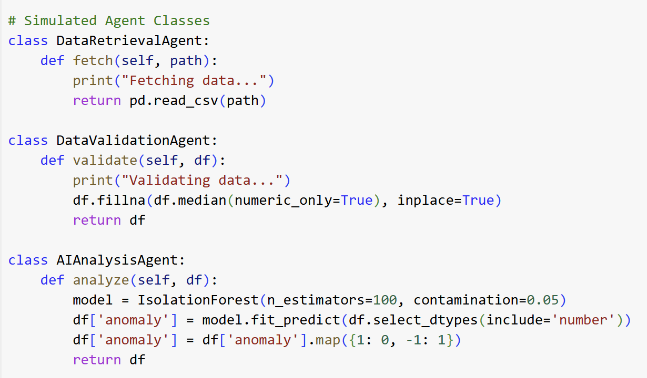
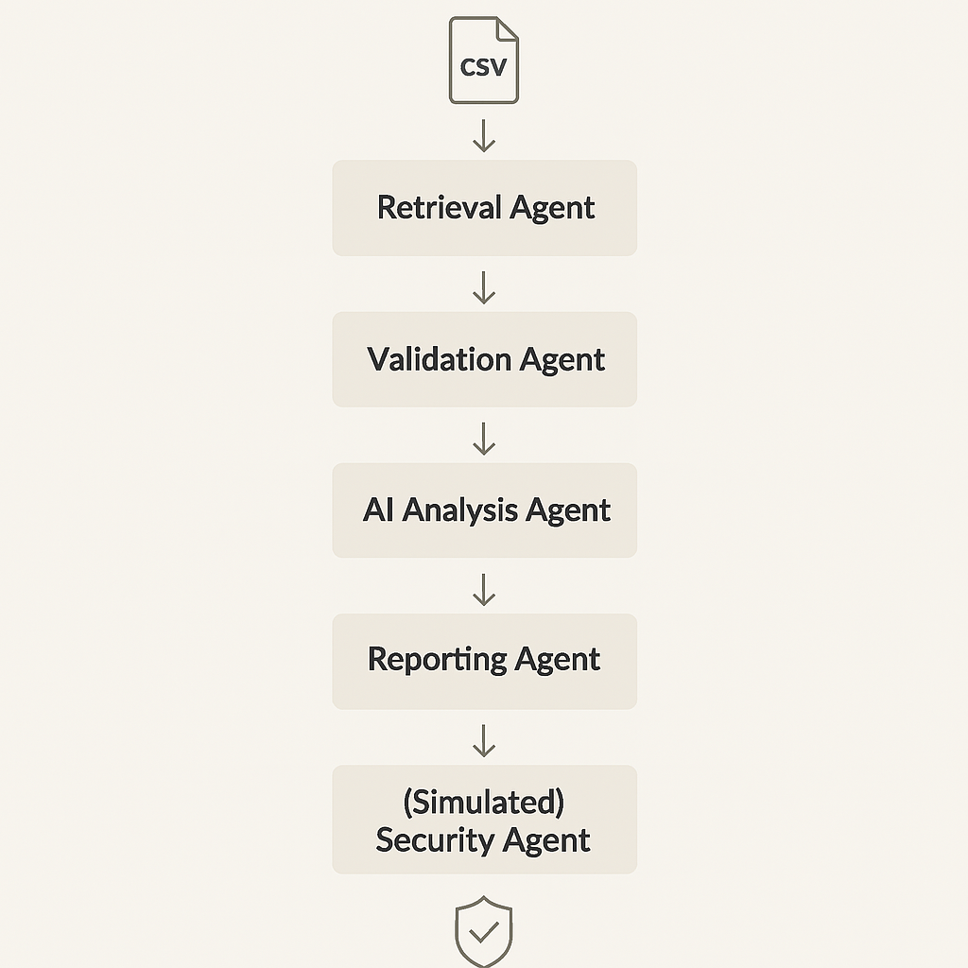
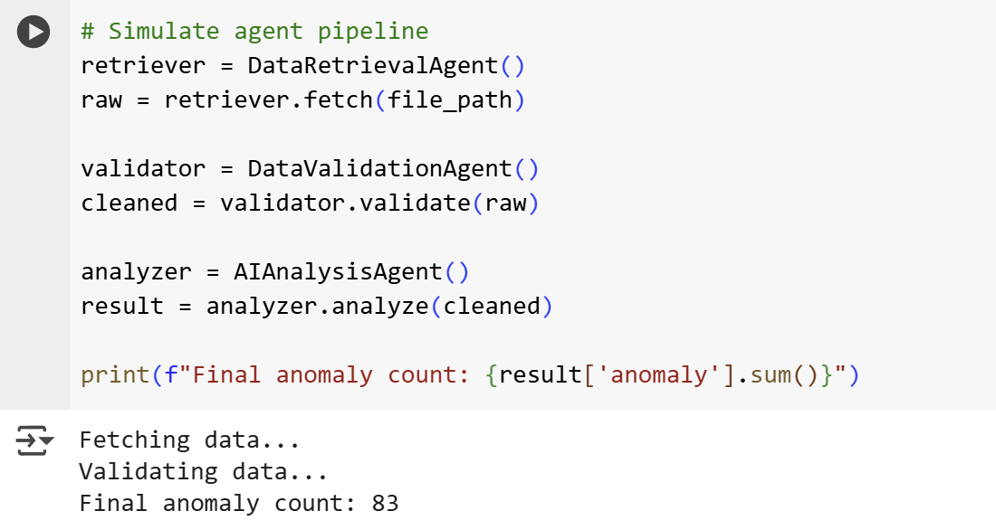
Agent Simulation
Notes:
To demonstrate the Multi-Agent System architecture, I developed a lightweight simulation in Python, where each agent acts as a modular, autonomous component with a distinct responsibility.
The Data Retrieval Agent loads the raw Fitbit data from a CSV file.
The Data Validation Agent performs preprocessing steps, including handling missing values and applying z-score standardisation to ensure consistent scaling across numerical features.
The AI Analysis Agent fits the Isolation Forest model and flags any records that deviate from expected behavioural patterns.
This modular design follows the principles outlined by Maes (1991), who advocated for the use of reactive, situated agents that operate independently—particularly effective in distributed or dynamic environments.
Although this version operates in a sequential and simulated environment, it offers clear separation of concerns, making each agent independently testable, maintainable, and scalable.
The architecture is intentionally extensible. In future developments, these agents could be deployed as microservices, connected to APIs from wearable devices, or embedded within real-time event-driven frameworks.
Ultimately, this simulation reflects how agent-based design can support scalable and adaptive systems in real-world applications like smart health monitoring and IoT.

Slide 8
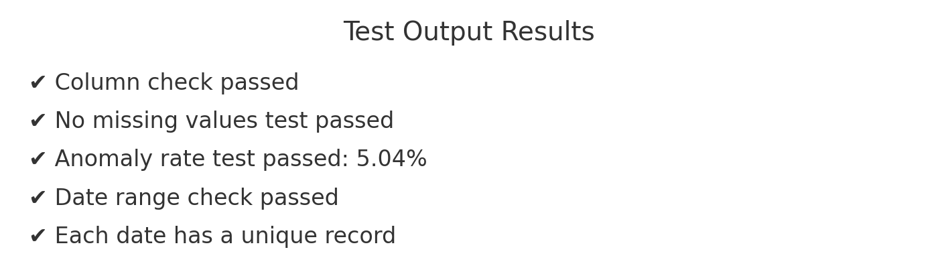

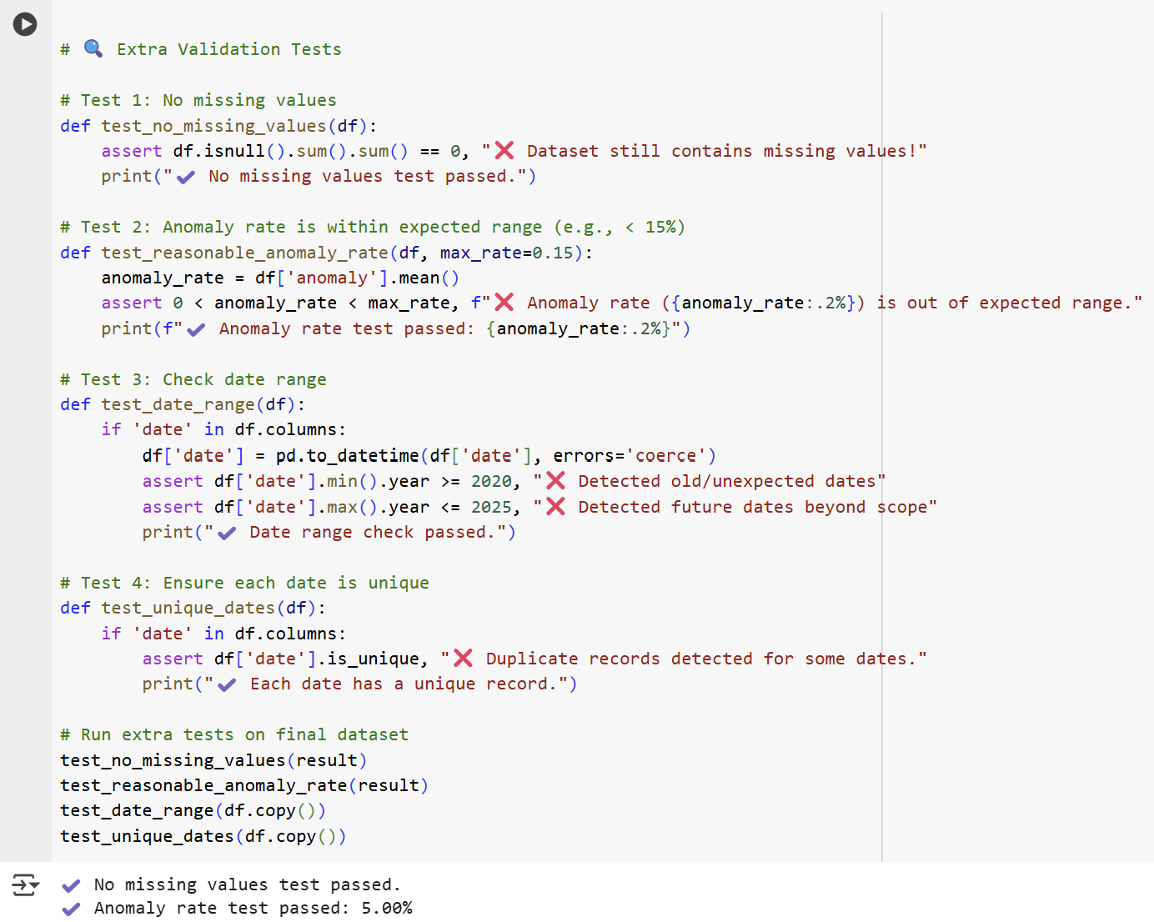



Testing & Validation
Column Check
Verified all required data fields exist
Missing Value Check
Confirmed proper handling of incomplete records
Anomaly Sanity Check
Validated anomaly detection results match expectations
Date Range & Uniqueness
Ensured chronological integrity of time series data
Notes:
Once the modular system was in place, I conducted a series of structured tests to validate both the data pipeline and the AI-driven components.
I began with a missing value check, confirming that all imputation steps — both numeric and categorical — had been successfully applied. This ensured the dataset was clean and ready for analysis.
Next, I validated the anomaly rate, which was recorded at approximately 5.04%, closely matching the 5% contamination threshold defined in the Isolation Forest model. This result confirmed that the model was neither overestimating nor underestimating anomalies.
A column check was also conducted to verify that all essential features — including steps, sleep score, VO2Max, and dates — were present and intact across the dataset.
I then ran date range and uniqueness tests to ensure the chronological integrity of the time-series data. Each record represented a unique calendar day, with no duplication or malformed timestamps — a key requirement for accurate behavioral tracking.
These validation steps are not just standard QA measures; they reflect the discipline of trustworthiness in AI systems. As Wang et al. (2016) point out, agent-based systems must operate with high data fidelity to support robust decision-making and inter-agent communication.
By passing all these tests, the system demonstrated both technical correctness and data integrity, which are foundational for ensuring credible performance monitoring.

Slide 9
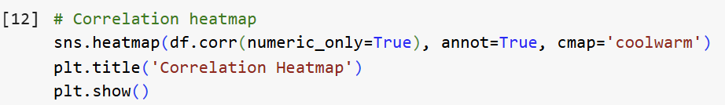
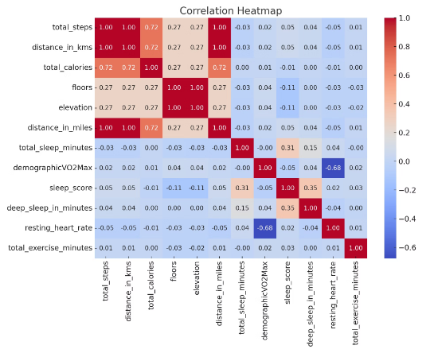
Code Quality & Commentary
Modular Structure
Code organized into logical components with clear dependencies.
Each agent implemented as separate class with defined interfaces.
Documentation
Comprehensive inline comments explain algorithmic decisions.
Function headers document inputs, outputs, and side effects.
Libraries
Pandas for data manipulation
Scikit-learn for ML models
Seaborn for visualizations
Notes:
The codebase for this project follows a modular, agent-oriented architecture, which not only reflects real-world multi-agent system (MAS) design but also adheres to best practices in software engineering — particularly in terms of maintainability, testability, and scalability.
Each agent was implemented as an independent Python class, with clearly defined responsibilities. This separation of concerns made it easier to debug, extend, and validate individual components without impacting the overall system.
I also embedded comprehensive inline comments throughout the code, not only explaining what the code does, but more importantly, why certain decisions were made. For instance:
Using the median for numeric imputation to reduce the influence of outliers.
Choosing Isolation Forest over One-Class SVM for its efficiency and performance with high-dimensional datasets.
Additionally, I included assert-based validation functions with contextual reasoning — such as ensuring the anomaly rate remains within the expected 5% range — to verify that the model behavior aligns with its design parameters.
This kind of critical code commentary is essential for bridging theory and implementation, as emphasized by Russell and Norvig (2021). It ensures that the code is not only functional, but also explainable, which is key in AI systems where transparency is as important as accuracy.
From a tooling perspective, I used standard libraries such as Pandas for data manipulation, Scikit-learn for machine learning, and Seaborn for visualizations — ensuring the system remains accessible, well-documented, and compatible with future data pipelines or real-time streaming inputs.

Slide 10
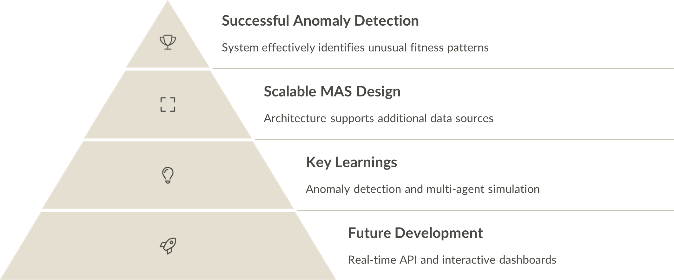
Conclusion & Reflection
“One limitation is the current model doesn’t provide reasoning for flagged anomalies — future versions may integrate SHAP for interpretability.”
“Security Agent is simulated — next step would be to connect it with OAuth for secure data access.”
Notes:
In conclusion, this project demonstrated the potential of combining unsupervised anomaly detection with modular multi-agent system architecture to monitor personal fitness data effectively.
By using Isolation Forest and structured Python agents, the system successfully identified unusual behavioral patterns across steps, sleep quality, and cardiovascular indicators.
The agent-oriented design brought clear benefits: flexibility, modularity, and scalability — qualities essential in real-world systems such as IoT-driven health monitoring. This reflects the direction suggested by Wang et al. (2016), who highlight the importance of intelligent coordination in Industry 4.0 and big data ecosystems.
One of the key challenges was model interpretability. Because the system relies on unsupervised methods, explaining why a data point was flagged as anomalous isn’t always straightforward. Using PCA helped visualize the output, but future versions could integrate tools like SHAP to provide interpretable AI explanations — an increasingly important aspect of ethical and trustworthy AI.
Through this project, I strengthened my skills in:
Python-based data cleaning and validation
Statistical and machine learning modeling
Modular code development and inline documentation
Agent-based simulation aligned with real-world design principles
I also gained deeper appreciation for the balance between technical performance and explainability — especially critical in health-related applications.
Looking ahead, this system could evolve by integrating with real-time APIs from wearable devices and supporting interactive dashboards for users and health professionals. The simulated Security Agent could be extended using standards like OAuth to ensure secure and ethical data access.
Thank you for following this journey — I hope it’s illustrated how AI can unlock actionable insights from everyday fitness data and support personalised, intelligent monitoring systems.

Slide 11
References
LinkNet Analytics (2023) My Fitbit Watch Datasets. Available at: https://www.kaggle.com/datasets/linknetanalytics/my-fitbit-watch-datasets (Accessed: 6 April 2025).
Maes, P. (1991) ‘The agent network architecture (ANA)’, ACM SIGART Bulletin, 2(4), pp. 115–120.
Mikolov, T., Sutskever, I., Chen, K., Corrado, G. and Dean, J. (2013) ‘Distributed representations of words and phrases and their compositionality’, Advances in Neural Information Processing Systems, 26, pp. 3111–3119.
Russell, S. and Norvig, P. (2021) Artificial intelligence: a modern approach. 4th edn. Harlow: Pearson Education.
Wang, S., Wan, J., Zhang, D., Li, D. and Zhang, C. (2016) ‘Towards smart factory for Industry 4.0: a self-organized multi-agent system with big data based feedback and coordination’, Computer Networks, 101, pp. 158–168.
Wooldridge, M.J. (2009) An introduction to multiagent systems. 2nd edn. New York: John Wiley & Sons.

